Slide 1

Tachyon Backend Role - Task 2 Resubmission
Rahul T
Backend Developer Role
Topic 1,2 & 4
Full Stack Task Management with Real-time Chat
Notes:
Hi everyone, my name is Rahul, and this is my resubmission for Tachyon Task 2, completed for the Backend Developer role.
In this task, I’ve built a full-stack task management application with integrated real-time communication.
The system allows users to register, log in securely, create and manage their tasks, and chat in real-time — all within one unified web platform.
The backend is completely developed using Flask, a lightweight Python framework, along with SQLite for persistent data storage and Flask-SocketIO to handle live chat functionality.
For the frontend, I’ve used HTML, CSS, and JavaScript to build a responsive and modern user interface.

Slide 2
Project Overview
Complete Full-Stack Task Management Application
Built with Flask + Socket.IO backend
Secure JWT-based authentication system
Real-time room-based chat integration
RESTful API supporting full CRUD operations
User-specific task creation, update, and tracking
Modern Vanilla JavaScript frontend with glassmorphic responsive UI
SQLite database for persistent data storage
Notes:
In this project, I’ve implemented three main topics:
1. REST API with CRUD Operations, built entirely with Flask. It supports creating, reading, updating, and deleting tasks, each linked to the logged-in user.
2. JWT Authentication, where I implemented token-based security with Werkzeug password hashing and JWT token generation.
3. Real-Time WebSocket Chat, using Flask-SocketIO to enable instant messaging across multiple users in room-based chats.
These three modules together make TaskFlow a complete full-stack

Slide 3
Topics Implemented
Topic 1: REST API with CRUD Operations
Complete RESTful API architecture built using Flask
Create, Read, Update, Delete operations for managing tasks
User-specific task management using JWT-based user IDs
Flask route decorators for API endpoints
Proper HTTP response codes and structured JSON responses
Integrated search and status update functionality for tasks
Topic 2: JWT Authentication
Secure token-based authentication system with JWT
User registration and login endpoints using Flask routes
Passwords securely stored using Werkzeug hashing
Protected routes with custom token verification decorator
Token expiration policy ensuring 7-day session validity

Slide 4
Topics Implemented (Continued)
Topic 4: Real-time WebSocket Chat
Flask-SocketIO integration for real-time communication
Room-based chat functionality for collaborative discussions
Instant message delivery and live updates across clients
Automatic client connect/disconnect management
Event-driven broadcasting for messages within rooms
CORS-enabled Socket.IO server for seamless frontend connection
Integration with Vanilla JavaScript frontend for dynamic chat interface

Slide 5
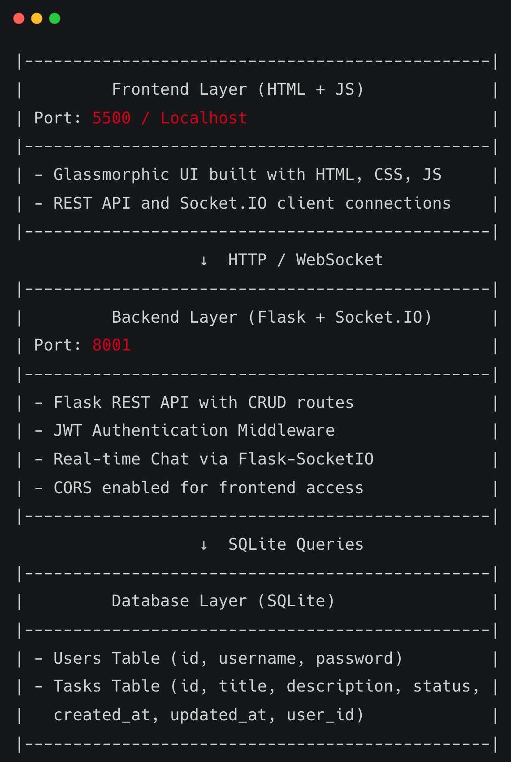
System Architecture
Clean separation of concerns with modular design
Stateless API architecture for scalability
Notes:
TaskFlow follows a three-tier architecture — frontend, backend, and database.
The frontend layer is built using HTML, CSS, and JavaScript. It handles user interactions and communicates with the backend through REST APIs and Socket.IO.
The backend layer is powered by Flask and Flask-SocketIO. It manages authentication, routes, and real-time chat.
The database layer uses SQLite to store users and tasks persistently.
I also designed it with clean separation of concerns, meaning each component handles its own responsibility — and the API is stateless, so every request is independent, improving scalability.
⸻

Slide 6
Technology Stack
Backend Technologies
Flask – Lightweight Python web framework for RESTful APIs
Flask-SocketIO – Real-time bidirectional communication
Flask-CORS – Enables cross-origin resource sharing
SQLite – Embedded relational database for persistent storage
Werkzeug – Secure password hashing and verification
JWT (PyJWT) – Token-based authentication and session management
Python – Backend programming language for logic and routing
Frontend Technologies
HTML5 – Structure and content of the web application
CSS3 – Styling with glassmorphic and responsive design
JavaScript (Vanilla JS) – Core logic and dynamic UI interactions
Fetch API – Handles RESTful API requests to the backend
Socket.IO Client – Enables real-time communication with Flask-SocketIO
Notes:
For the backend, I used Flask, Flask-SocketIO, Flask-CORS, Werkzeug, SQLite, and PyJWT.
Flask provides the API structure, Socket.IO enables real-time chat, and SQLite stores persistent task data.
Werkzeug securely hashes passwords, and JWT handles authentication.
For the frontend, I used pure HTML, CSS, and JavaScript — no frameworks — to keep it lightweight.
The Fetch API is used for calling backend endpoints, and the Socket.IO client manages live communication between users.

Slide 7
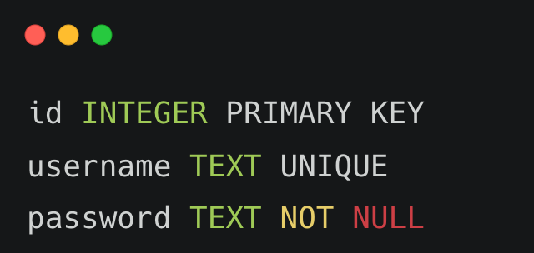
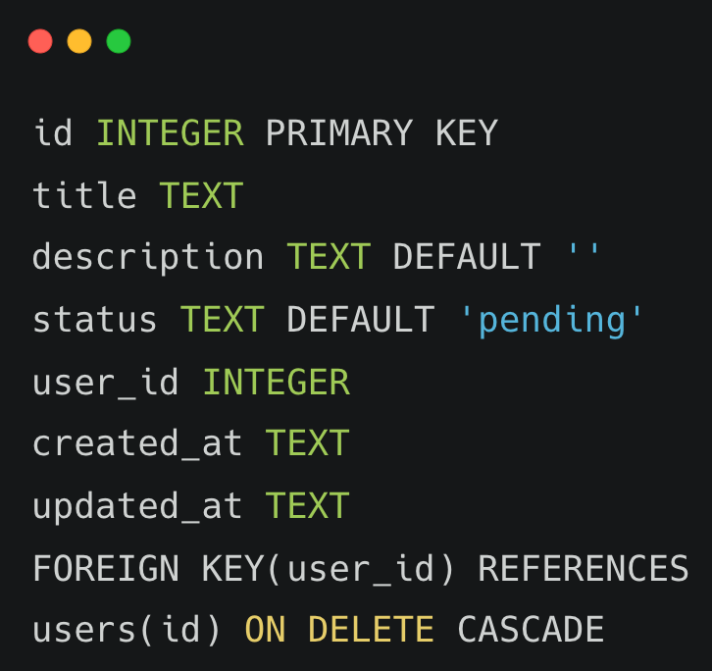
Database Schema
User Model
Task Model
Notes:
The database is minimal but efficient.
It contains two main tables — Users and Tasks.
The Users table stores a unique username and a securely hashed password.
The Tasks table includes task title, description, status, timestamps, and a user ID linking it to its creator.
A foreign key constraint ensures that when a user is deleted, their tasks are automatically removed — maintaining clean data relationships.
This one-to-many design allows each user to manage their own tasks independently.

Slide 8
API Endpoints
Authentication APIs
POST /api/auth/register – User registration with secure password hashing using Werkzeug
POST /api/auth/login – User login with JWT token generation (7-day validity)
Task Management APIs (Protected)
GET /api/tasks – Fetch all tasks for the authenticated user (supports search)
POST /api/tasks – Create a new task with title, description, and timestamp
PUT /api/tasks/<id> – Update existing task details and status
DELETE /api/tasks/<id> – Delete a specific task belonging to the user
PATCH /api/tasks/<id>/complete – Mark a task as completed
Health Check
GET / – Root endpoint confirming Flask server is running
Notes:
My Flask backend exposes clean REST endpoints:
For authentication — /api/auth/register for signup and /api/auth/login for token generation.
For task management — I implemented /api/tasks for CRUD operations and a /api/tasks/<id>/complete route to mark tasks as done.
Each of these routes is protected by a @token_required decorator that ensures only logged-in users can access their own data.
I also added a / root route to verify server health.
Every endpoint returns structured JSON responses for smooth frontend integration.

Slide 9
JWT Authentication Flow
1. User Registration/Login
└── Client sends username and password via JSON request
2. Server Validation
└── Password hashed and verified using Werkzeug security module
3. Token Generation
└── Server creates a JWT containing user ID (7-day expiry)
4. Client Storage
└── Token stored securely in browser localStorage
5. Authenticated Requests
└── Client includes JWT in the Authorization header (Bearer token)
6. Token Verification
└── Custom @token_required decorator verifies token signature and expiry
✅ Stateless authentication – No server-side session storage required
Notes:
Here’s how the authentication flow works:
When a user registers or logs in, the backend validates their credentials and hashes the password using Werkzeug.
A JWT token is then generated containing their user ID, valid for seven days.
This token is stored in the browser’s localStorage.
Every time the user performs an action, like adding or viewing tasks, the token is sent in the Authorization header.
On the backend, my decorator verifies the token’s validity and extracts the user ID — ensuring each request is authenticated and secure.
Since the API is stateless, no session storage is needed — the token itself carries the authentication data.

Slide 10
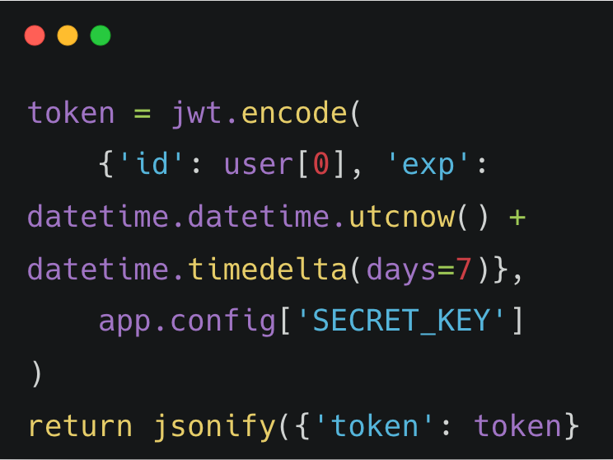
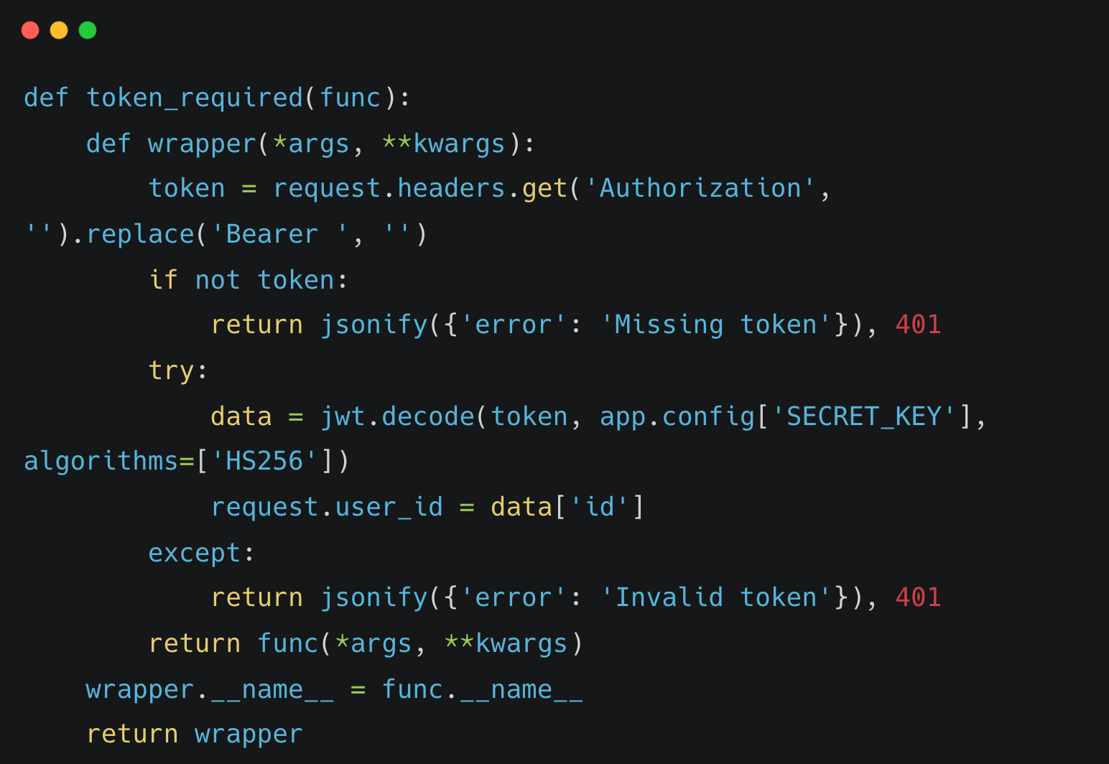
JWT Implementation Code
Token Generation (Login/Register)
Token Verification Middleware
Notes:
Here are the two key code snippets that power the JWT authentication flow.
I’ll be showing this in more detail during the live code walkthrough, but this is the core logic behind how authentication works.
On the left, we have token generation.
After a user’s credentials are validated, we create a JWT using jwt.encode(), passing in a payload that includes the user’s ID and an expiry time of seven days.
The token is then signed using the app’s secret key, which is stored securely in the Flask configuration.
This token is returned to the client and stored in the browser’s localStorage.
On the right is the token verification decorator.
In Flask, I implemented this as a custom @token_required function.
It extracts the token from the Authorization header, removes the “Bearer” prefix, and uses jwt.decode() to verify the token using the same secret key.
If the token is valid, the user’s ID is attached to the request so protected routes can identify the authenticated user.
If the token is missing or invalid, it immediately returns a 401 error — either “Missing token” or “Invalid token.”
Together, these two snippets form a stateless authentication flow, ensuring that every request is verified securely without storing sessions on the server.

Slide 11
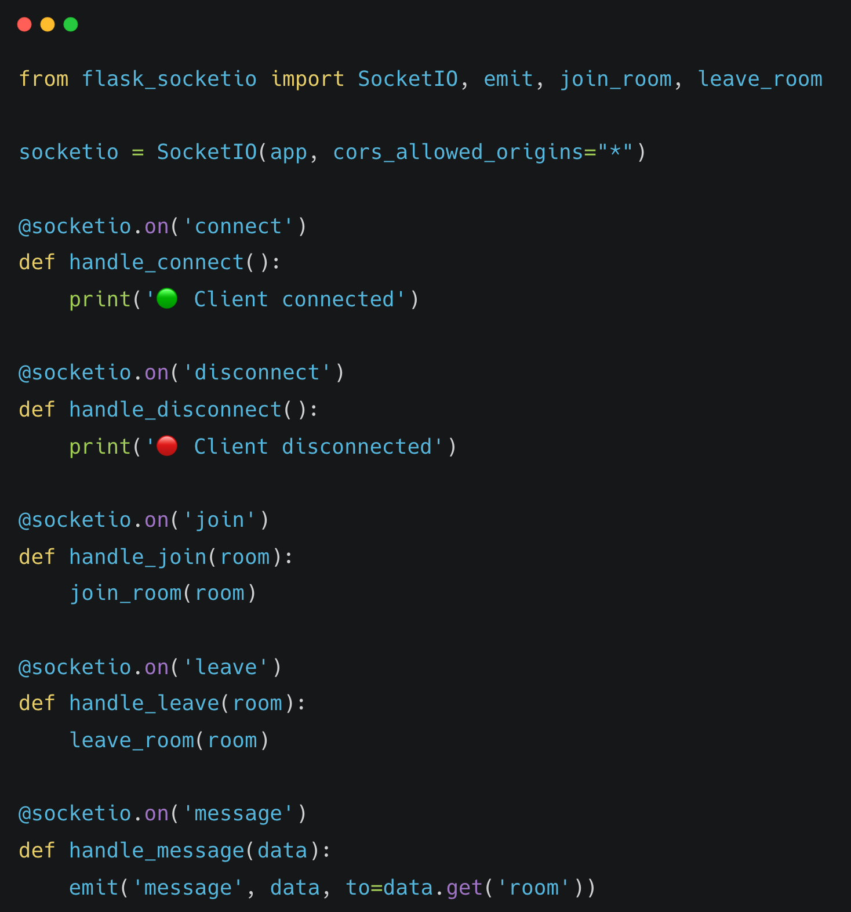
WebSocket (Socket.io) Implementation
Server Setup
Notes:
Real-time chat is powered by Flask-SocketIO.
When a user connects, they join a room identified by a custom room name.
Messages sent to that room are instantly broadcast to all connected clients using the emit() method.
Users can also leave rooms dynamically, and connection and disconnection events are handled cleanly.
This allows multiple users to communicate simultaneously with zero page reloads.
On the frontend, the Socket.IO client in app.js manages message sending and updates the chat UI instantly

Slide 12
Key Features Implemented
1. Secure Authentication
└── JWT tokens with Werkzeug password hashing
2. Complete Task CRUD
└── Create, read, update, delete tasks with full validation
3. User Task Isolation
└── Each user can access only their own tasks (via user ID binding)
4. Real-Time Chat
└── Flask-SocketIO powered instant messaging with room support
5. Modern Responsive UI
└── Clean glassmorphic interface built with HTML, CSS, and JavaScript
6. Performance Optimized
└── Lightweight SQLite database with efficient query execution
7. Security Best Practices
└── Input validation, error handling, and CORS-enabled API access
Notes:
Here are the main features of TaskFlow:
It supports secure authentication using JWT and Werkzeug.
Complete CRUD operations for managing tasks.
Each user’s tasks are fully isolated, thanks to JWT filtering.
A built-in real-time chat lets users collaborate instantly.
The frontend is modern, responsive, and visually appealing using glassmorphism.
The system is optimized for performance, with lightweight SQLite queries and no unnecessary overhead.
Security features like validation, error handling, and CORS make it safe for deployment.

Slide 13
Security Implementation
Password Hashing: Secure hashing using Werkzeug with salted encryption
JWT Tokens: Signed with Flask SECRET_KEY, 7-day expiry for authentication
Protected Routes: Custom @token_required decorator applied to all task APIs
User Data Isolation: SQL queries filtered by user_id from verified JWT
CORS Configuration: Managed using Flask-CORS for safe frontend-backend communication
Input Validation: Request data validated and sanitized before database operations
Error Handling: Returns safe, generic error messages without exposing server details
SQL Injection Prevention: Parameterized queries using Python’s sqlite3 module
Token Verification: JWT decoded and verified on every protected API request
Notes:
Security was a major focus.
Passwords are securely hashed using Werkzeug before storing in the database.
JWT tokens are signed with a secret key and expire after seven days.
All routes that deal with user data are protected by the @token_required decorator.
Requests are filtered by user ID to ensure users can access only their own data.
CORS is configured to allow safe frontend-backend communication.
All user input is validated, and error messages are generic to prevent information leaks.
Parameterized SQLite queries protect the app from SQL injection attacks.

Slide 14
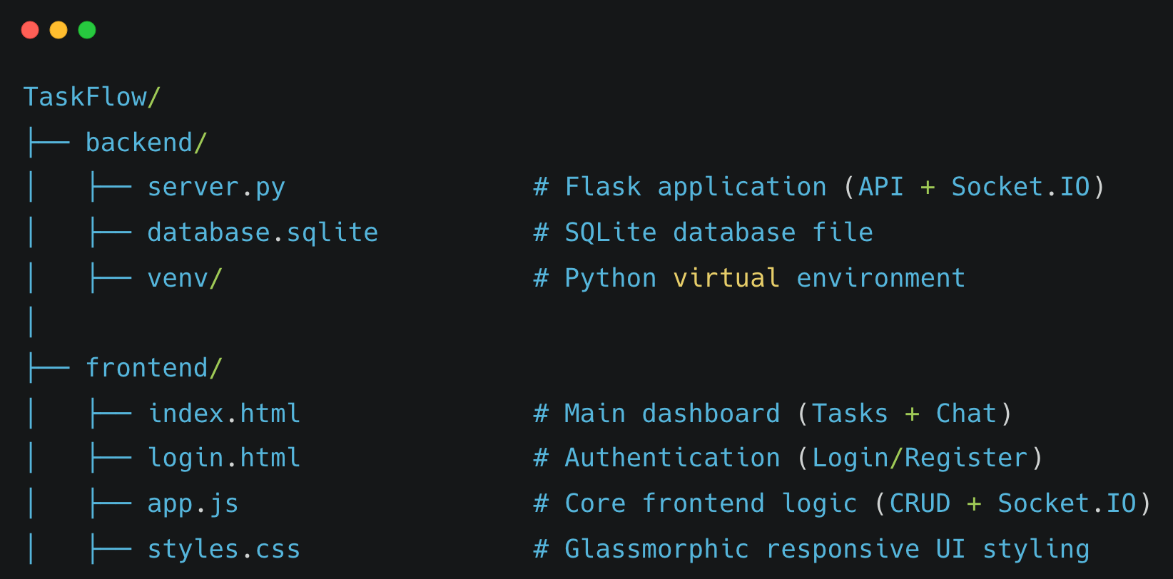
Project Structure
Directory Structure
Notes:
The project is neatly organized.
The backend folder contains server.py and the SQLite database.
server.py handles everything — authentication, task routes, and Socket.IO events.
The frontend folder contains HTML, CSS, and JavaScript files.
index.html is the main dashboard, login.html handles authentication, and app.js controls logic for tasks and chat.
This structure makes the project modular and easy to extend in the future — for example, by adding file sharing or notifications.

Slide 15
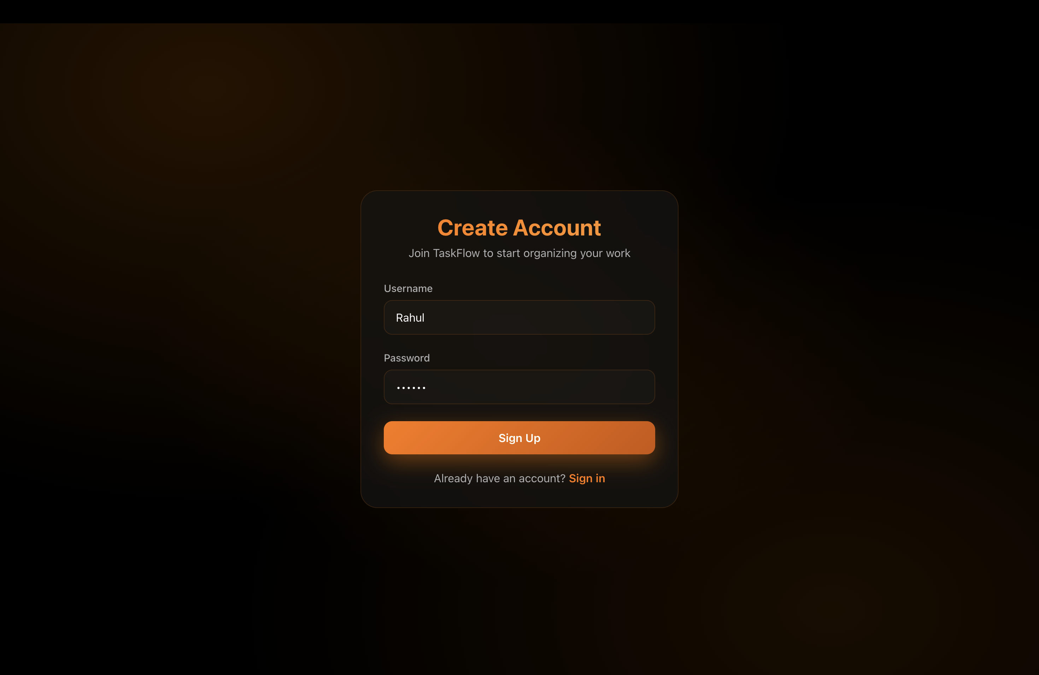
Project Screenshots
User registration form with secure input validation and Werkzeug password hashing.
Notes:
the following slides are screenshots of the application, but rather than just walking you through static images, I'd like to switch over now and show you the 'TaskFlow' application running live.

Slide 16
Project Screenshots
Login interface for JWT-based authentication, ensuring secure user access.

Slide 17
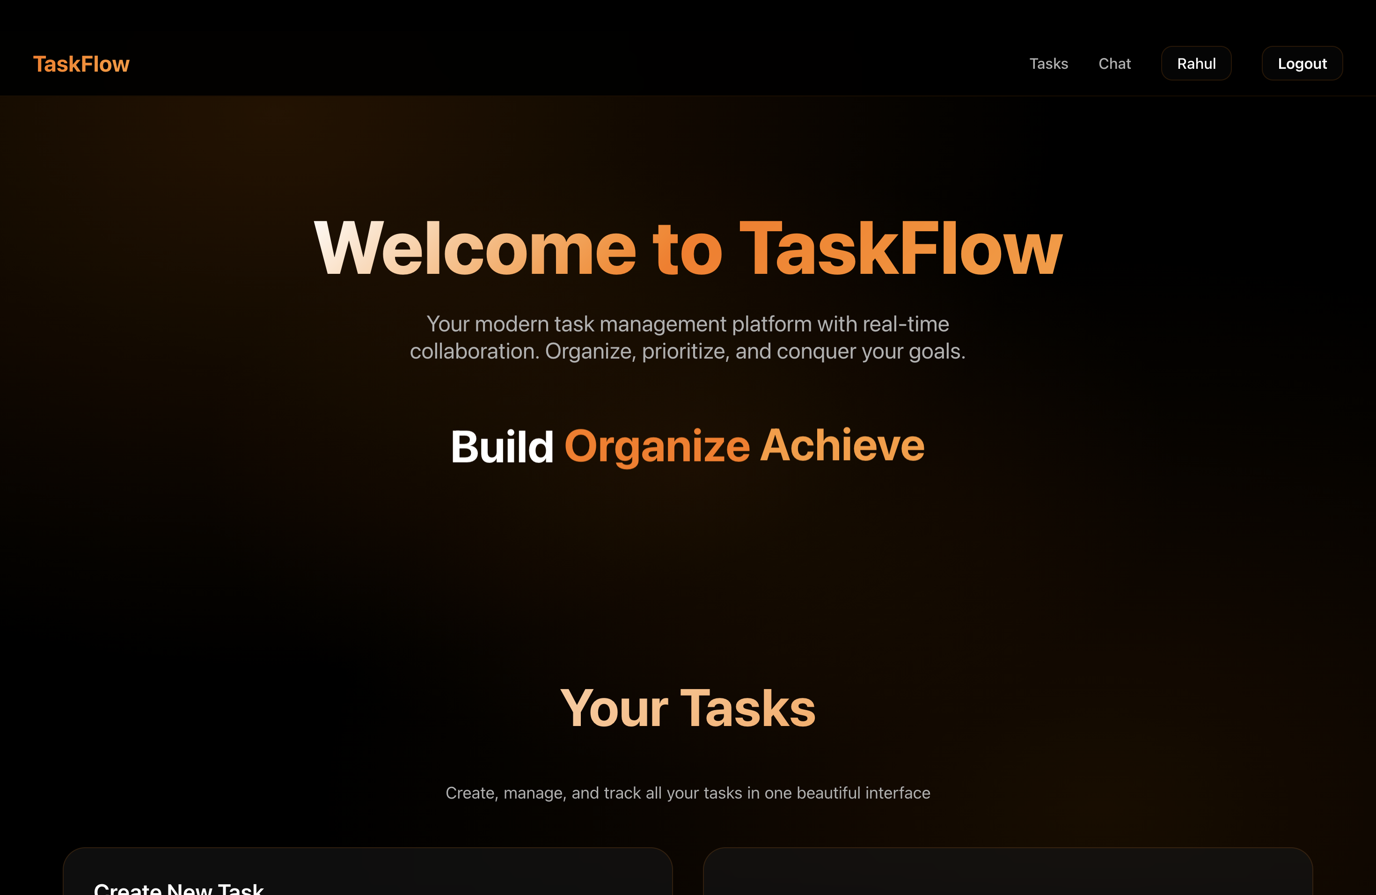
Project Screenshots
Welcome to TaskFlow: A clean and responsive HTML, CSS, and JavaScript-based homepage for seamless task management.

Slide 18
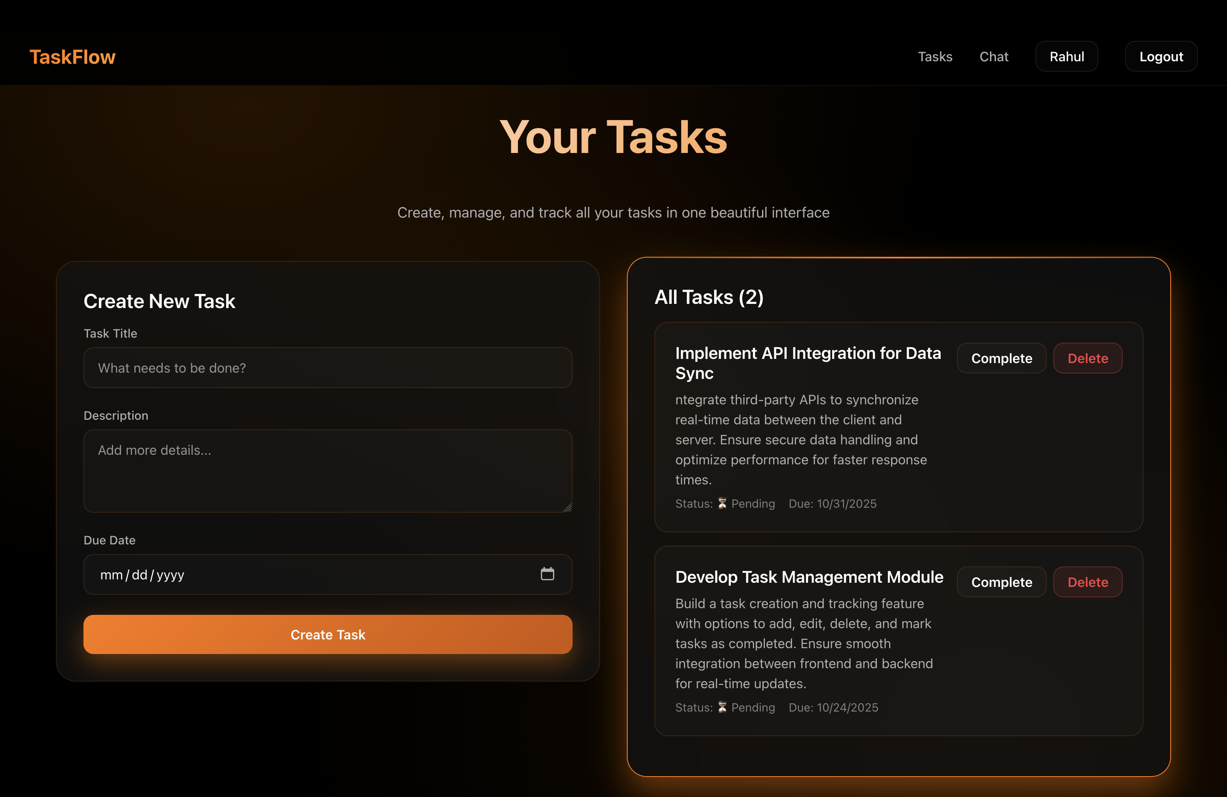
Project Screenshots
User-specific task dashboard with CRUD functionality, built with Vanilla JavaScript and Flask RESTful API integration.

Slide 19
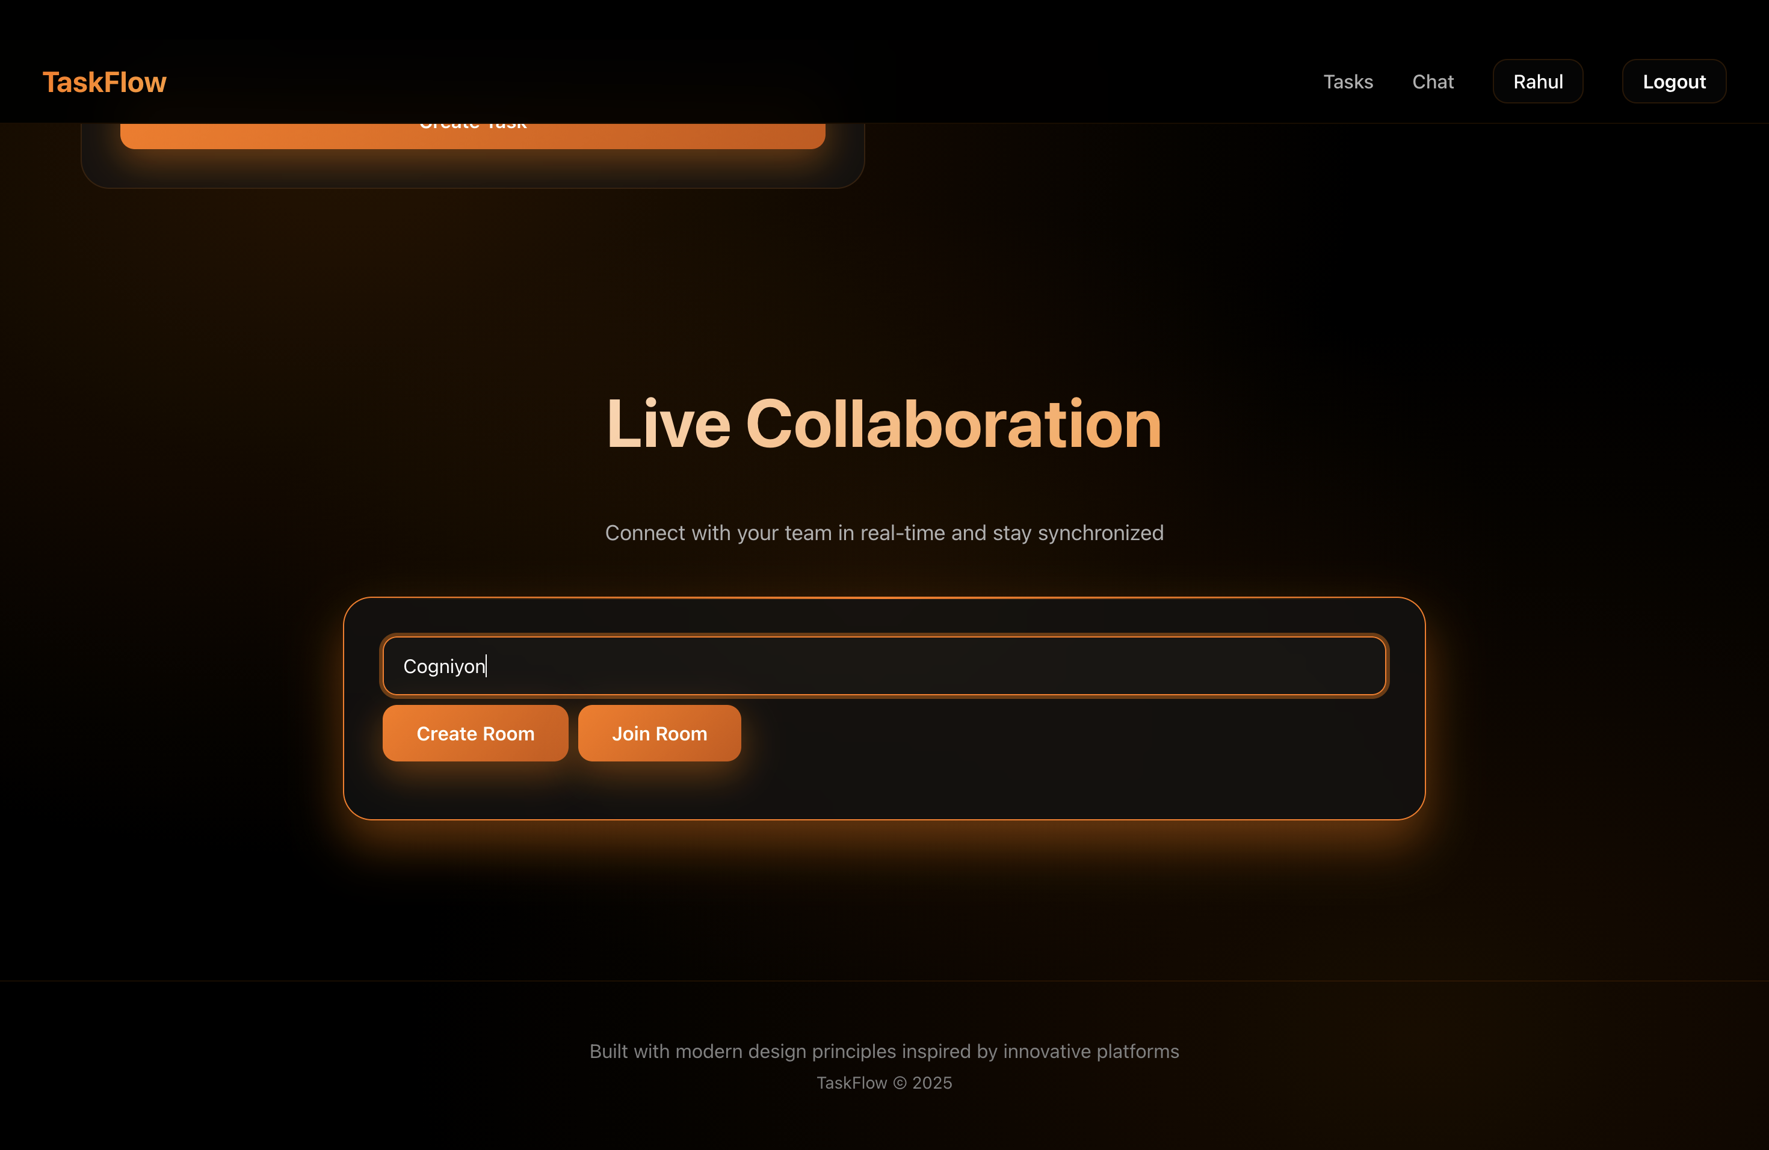
Project Screenshots
Flask-SocketIO-powered chat interface enabling instant messaging with room-based functionality.

Slide 20
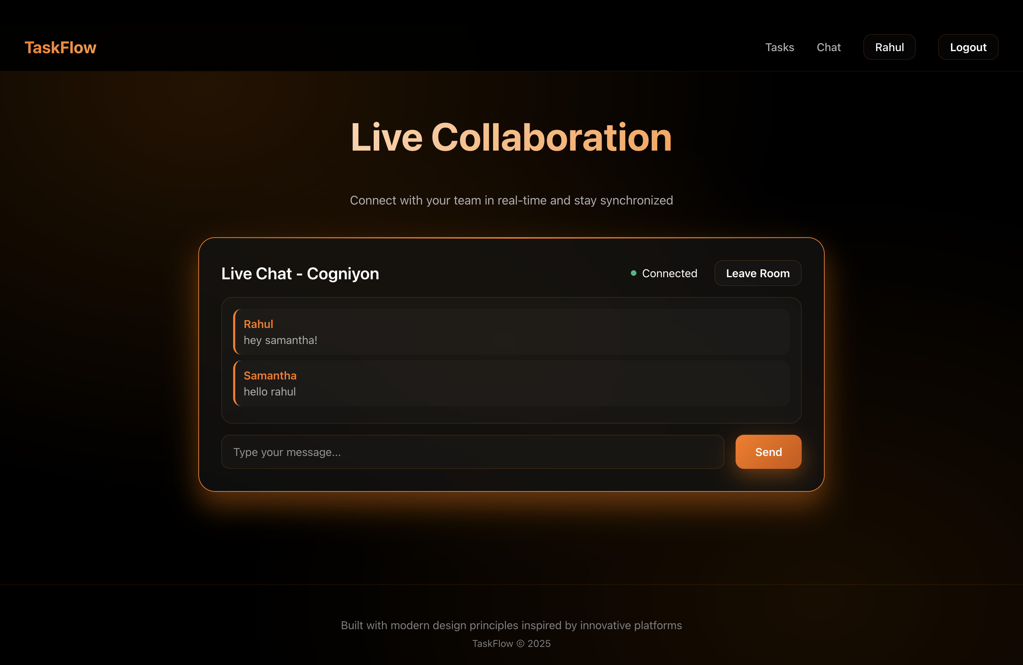
Project Screenshots
Caption
Caption

Slide 21
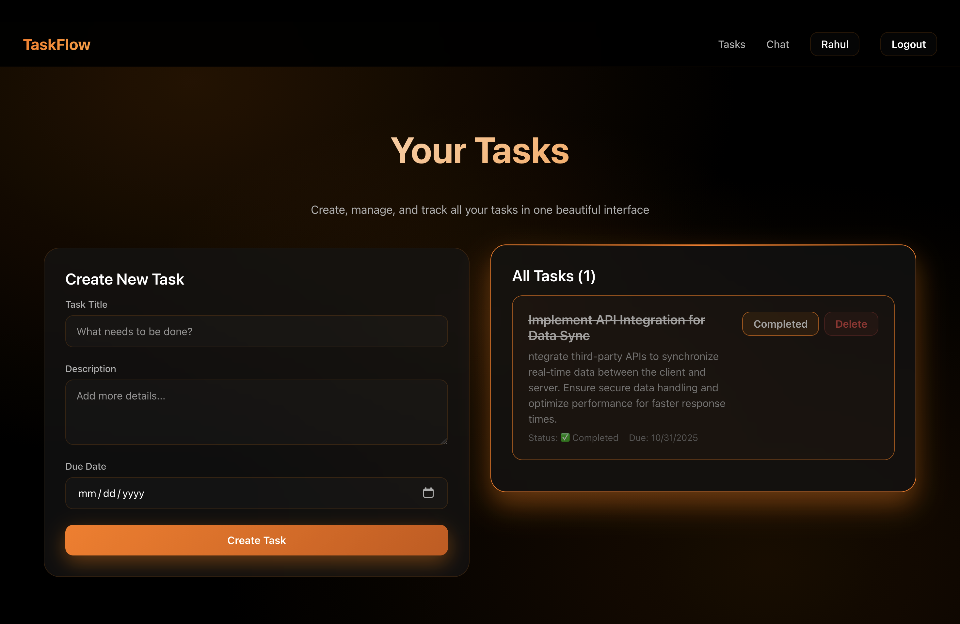
Project Screenshots
Displays user-specific tasks with options to edit or delete, ensuring JWT-based data isolation.

Slide 22
Testing & Validation Results
Backend API Testing (via curl/Postman)
User registration with Werkzeug password hashing
User login with JWT token generation (7-day expiry)
Task creation with authenticated user association
Task retrieval with user-specific filtering via JWT ID
@token_required middleware blocks unauthorized access
All endpoints tested using Postman and curl
Frontend Integration Testing
User signup flow with validation
User login with token storage
Task isolation between different users
Real-time chat with multiple clients
WebSocket room-based messaging
Notes:
I tested the backend APIs using Postman and curl.
During testing, I verified user registration, JWT token generation, and CRUD operations.
I also confirmed that only authenticated users can access their own tasks.
Unauthorized requests were correctly blocked by the middleware.
Every endpoint returned proper HTTP response codes and JSON data, confirming both reliability and security.
This ensured the entire backend worked seamlessly before integrating the frontend
After backend validation, I integrated and tested the frontend.
The signup and login flows worked smoothly with input validation and token storage.
Each user only saw their own tasks, verifying isolation logic.
I tested real-time chat by connecting multiple browser windows — messages appeared instantly across all clients.
Room-based messaging worked perfectly, ensuring proper event-based synchronization.
Overall, the frontend and backend communicated efficiently through both REST and WebSocket channels.

Slide 23
Challenges & Solutions
Challenge 1: User Task Isolation
Problem: Tasks were visible to all users without restriction
Solution: Implemented JWT-based user ID filtering in all task queries
Challenge 2: Real-Time Communication
Problem: Difficulty achieving live, bidirectional messaging
Solution: Integrated Flask-SocketIO with room-based events for real-time chat
Challenge 3: API Architecture
Problem: Handling multiple API routes efficiently in Flask
Solution: Designed modular REST API structure with decorators and route segregation
Notes:
During development, I faced three major challenges.
First, implementing user task isolation — initially, tasks were visible to all users. I solved this by filtering every task query using the JWT’s user ID.
Second, building real-time communication was tricky. Flask-SocketIO solved this by providing room-based event handling.
Third, managing routes in Flask could get messy, so I organized them modularly and used decorators for authentication.
These solutions made the system cleaner, faster, and more secure overall.

Slide 24
Future Enhancements & Scope
OAuth2 Integration (Google, GitHub, Microsoft)
Task Analytics Dashboard with charts
Task categories, tags, and labels
Task sharing and team collaboration
File attachments for tasks
Email notifications for task updates
Notes:
In the future, I plan to add OAuth2 login using Google or GitHub for smoother authentication.
I’d also like to create a task analytics dashboard with visual charts, plus support for tags and labels.
Another goal is team collaboration features, such as shared tasks and role-based access.
Finally, I want to include file attachments and email notifications for upcoming tasks.
These enhancements would make TaskFlow even more powerful and ready for enterprise-level use.

Slide 25
Thank You! 🙏
Tachyon - Task 2-Resubmission
Rahul T
Backend Developer Role
Topics Completed: 1, 2 & 4 ✅
Gtihub Link: https://github.com/therahul-yo/tachyon-backend-task-2-Resubmission.git
Notes:
That concludes my application walkthrough for the Backend Developer role. In this resubmission, I’ve demonstrated my project, which implements topics 1, 2, and 4. I’ve built a secure, real-time, full-stack application that fulfills all the core requirements.
Thank you very much for your time and for giving me this opportunity.

